Slide 1
硬體描述語言
Homework 01
班級：資工二
學號：S1154041
姓名：邱立宇
日期：2023/10/26

Slide 2
作業 Verilog Code (sort4_tb.v)
module sort4_tb;
reg [7:0] x0, x1, x2, x3;
wire [7:0] y0, y1, y2, y3;
sort4 sorter(x0, x1, x2, x3, y0, y1, y2, y3);
initial
$monitor("TIme: %3t ns, Input: x0=%2d,x1=%2d,x2=%2d,x3=%2d,Output: y0=%2d,y1=%2d,y2=%2d,y3=%2d", $time,x0, x1, x2, x3, y0, y1, y2, y3);
initial begin
#10 x0 = 8'd4; x1 = 8'd3; x2 = 8'd2; x3 = 8'd1;
#10 x0 = 8’d1; x1 = 8’d4; x2 = 8’d3; x3 = 8’d2;
#10 x0 = 8'd25; x1 = 8'd92; x2 = 8'd3; x3 = 8'd8;
#10 x0 = 8'd32; x1 = 8'd0; x2 = 8'd79; x3 = 8'd64;
#20 $finish;
end
endmodule

Slide 3
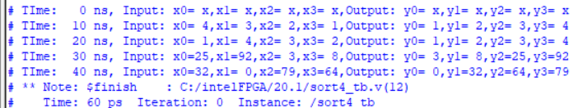
作業 Text Message Output (無延遲)
# TIme: 0 ns, Input: x0= x,x1= x,x2= x,x3= x,Output: y0= x,y1= x,y2= x,y3= x
# TIme: 10 ns, Input: x0= 4,x1= 3,x2= 2,x3= 1,Output: y0= 1,y1= 2,y2= 3,y3= 4
# TIme: 20 ns, Input: x0= 1,x1= 4,x2= 3,x3= 2,Output: y0= 1,y1= 2,y2= 3,y3= 4
# TIme: 30 ns, Input: x0=25,x1=92,x2= 3,x3= 8,Output: y0= 3,y1= 8,y2=25,y3=92
# TIme: 40 ns, Input: x0=32,x1= 0,x2=79,x3=64,Output: y0= 0,y1=32,y2=64,y3=79
# ** Note: $finish : C:/intelFPGA/20.1/sort4_tb.v(12)
# Time: 60 ps Iteration: 0 Instance: /sort4_tb

Slide 4
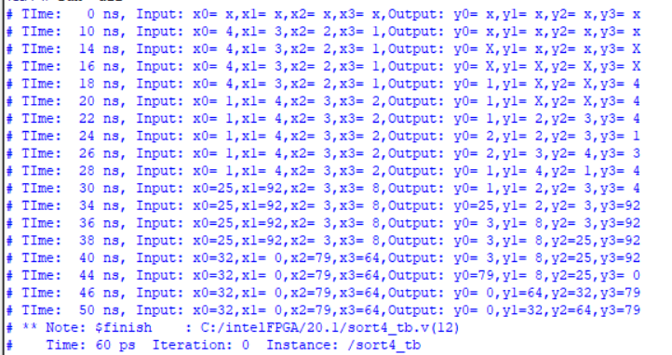
作業 Text Message Output (有延遲 #2 )

Slide 5
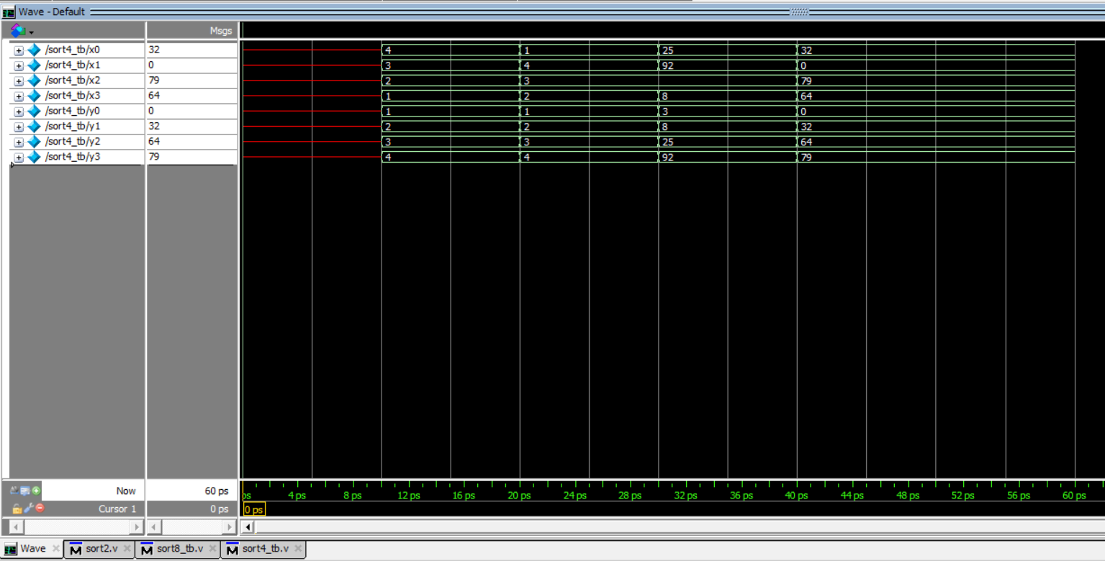
作業 Simulation Waveform (無延遲)

Slide 6
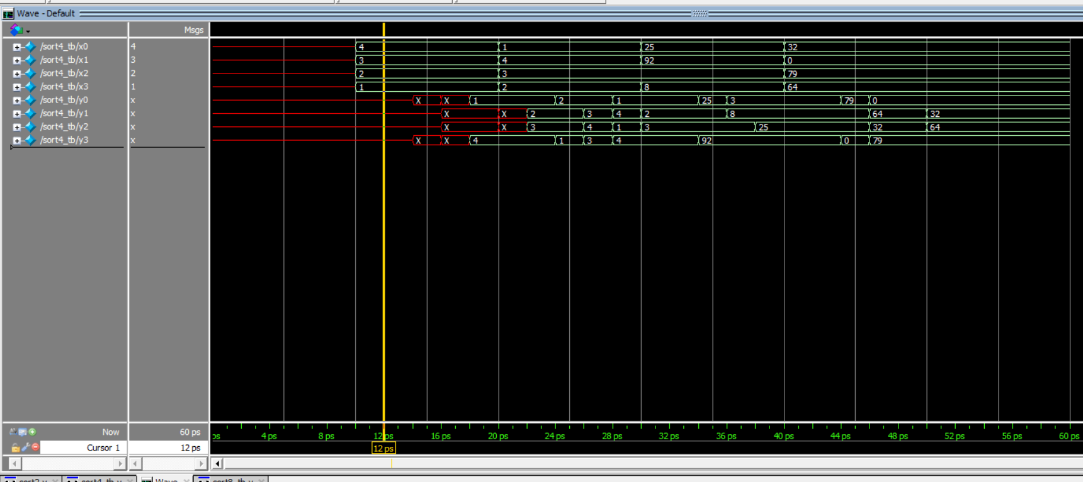
作業 Simulation Waveform (有延遲#2)

Slide 7
挑戰題 sort8電路方塊圖
x0
Sort4_1
L1
Sort4_3
y0
x1
L2
y1
x2
W1
s1
Sort4_5
x3
W2
s2
x4
Sort4_2
L3
Sort4_4
s3
x5
L4
s4
x6
W3
y6
x7
W4
y7
Sort4_5
y1
y2
Sort4 會將數字從上到下,由小排到大,
將輸入(x0 ~ x7) 排好成輸出 (y0 ~ y7)
y3
y4

Slide 8
挑戰題 Verilog Code (sort8_tb.v)
module sort8_tb;
reg[7:0] x0, x1, x2, x3, x4, x5, x6, x7;
wire[7:0] y0, y1, y2, y3, y4, y5, y6, y7;
sort8 sorter(x0, x1, x2, x3, x4, x5, x6, x7, y0, y1, y2, y3, y4, y5, y6, y7);
initial
$monitor("Time: %3d ns, Input: x0 = %2d, x1 = %2d, x2 = %2d, x3 = %2d, x4 = %2d, x5 = %2d, x6 = %2d, x7 = %2d Output: y0 = %2d, y1 = %2d, y2 = %2d, y3 = %2d, y4 = %2d, y5 = %2d, y6 = %2d, y7 = %2d", $time,x0, x1, x2, x3, x4, x5, x6, x7, y0, y1, y2, y3, y4, y5, y6, y7);
initial begin
#10 x0 = 8'd8; x1 = 8'd7; x2 = 8'd6; x3 = 8'd5; x4 = 8'd4; x5 = 8'd3; x6 = 8'd2; x7 = 8'd1;
#10 x0 = 8'd5; x1 = 8'd6; x2 = 8'd7; x3 = 8'd8; x4 = 8'd1; x5 = 8'd2; x6 = 8'd3; x7 = 8'd4;
#10 x0 = 8'd8; x1 = 8'd7; x2 = 8'd4; x3 = 8'd3; x4 = 8'd5; x5 = 8'd6; x6 = 8'd2; x7 = 8'd1;
#10 x0 = 8'd18; x1 = 8'd72; x2 = 8'd36; x3 = 8'd58; x4 = 8'd44; x5 = 8'd73; x6 = 8'd27; x7 = 8'd31;
#10 x0 = 8'd80; x1 = 8'd86; x2 = 8'd56; x3 = 8'd1; x4 = 8'd52; x5 = 8'd12; x6 = 8'd20; x7 = 8'd17;
#10 x0 = 8'd8; x1 = 8'd17; x2 = 8'd69; x3 = 8'd42; x4 = 8'd90; x5 = 8'd0; x6 = 8'd89; x7 = 8'd42;
#20 $finish;
end
endmodule

Slide 9
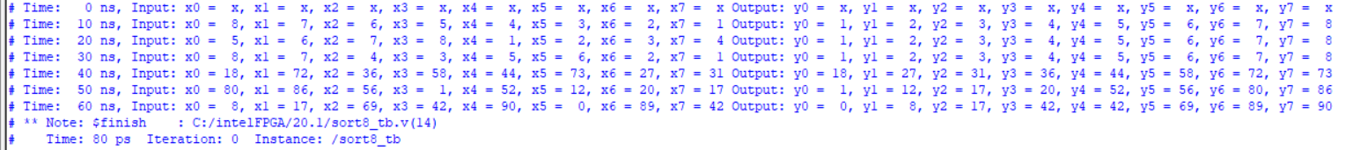
挑戰題 Text Message Output (無延遲)
# Time: 0 ns, Input: x0 = x, x1 = x, x2 = x, x3 = x, x4 = x, x5 = x, x6 = x, x7 = x Output: y0 = x, y1 = x, y2 = x, y3 = x, y4 = x, y5 = x, y6 = x, y7 = x
# Time: 10 ns, Input: x0 = 8, x1 = 7, x2 = 6, x3 = 5, x4 = 4, x5 = 3, x6 = 2, x7 = 1 Output: y0 = 1, y1 = 2, y2 = 3, y3 = 4, y4 = 5, y5 = 6, y6 = 7, y7 = 8
# Time: 20 ns, Input: x0 = 5, x1 = 6, x2 = 7, x3 = 8, x4 = 1, x5 = 2, x6 = 3, x7 = 4 Output: y0 = 1, y1 = 2, y2 = 3, y3 = 4, y4 = 5, y5 = 6, y6 = 7, y7 = 8
# Time: 30 ns, Input: x0 = 8, x1 = 7, x2 = 4, x3 = 3, x4 = 5, x5 = 6, x6 = 2, x7 = 1 Output: y0 = 1, y1 = 2, y2 = 3, y3 = 4, y4 = 5, y5 = 6, y6 = 7, y7 = 8
# Time: 40 ns, Input: x0 = 18, x1 = 72, x2 = 36, x3 = 58, x4 = 44, x5 = 73, x6 = 27, x7 = 31 Output: y0 = 18, y1 = 27, y2 = 31, y3 = 36, y4 = 44, y5 = 58, y6 = 72, y7 = 73
# Time: 50 ns, Input: x0 = 80, x1 = 86, x2 = 56, x3 = 1, x4 = 52, x5 = 12, x6 = 20, x7 = 17 Output: y0 = 1, y1 = 12, y2 = 17, y3 = 20, y4 = 52, y5 = 56, y6 = 80, y7 = 86
# Time: 60 ns, Input: x0 = 8, x1 = 17, x2 = 69, x3 = 42, x4 = 90, x5 = 0, x6 = 89, x7 = 42 Output: y0 = 0, y1 = 8, y2 = 17, y3 = 42, y4 = 42, y5 = 69, y6 = 89, y7 = 90
# ** Note: $finish : C:/intelFPGA/20.1/sort8_tb.v(14)
# Time: 80 ps Iteration: 0 Instance: /sort8_tb

Slide 10
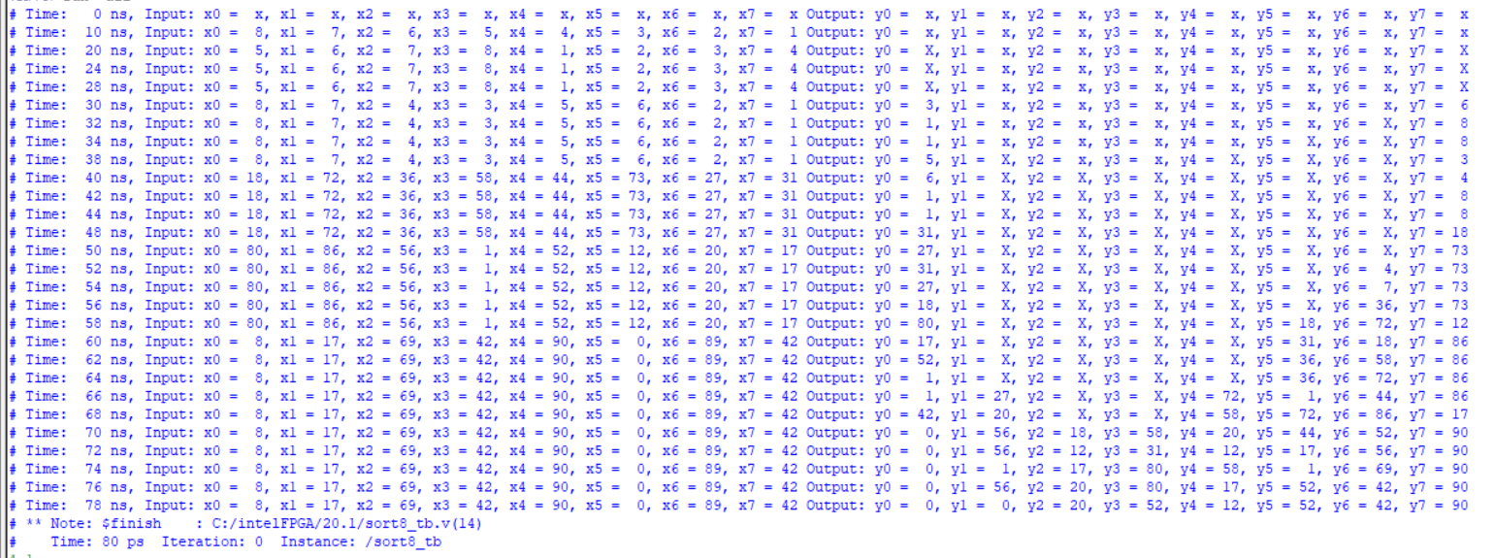
挑戰題 Text Message Output (有延遲#2)

Slide 11
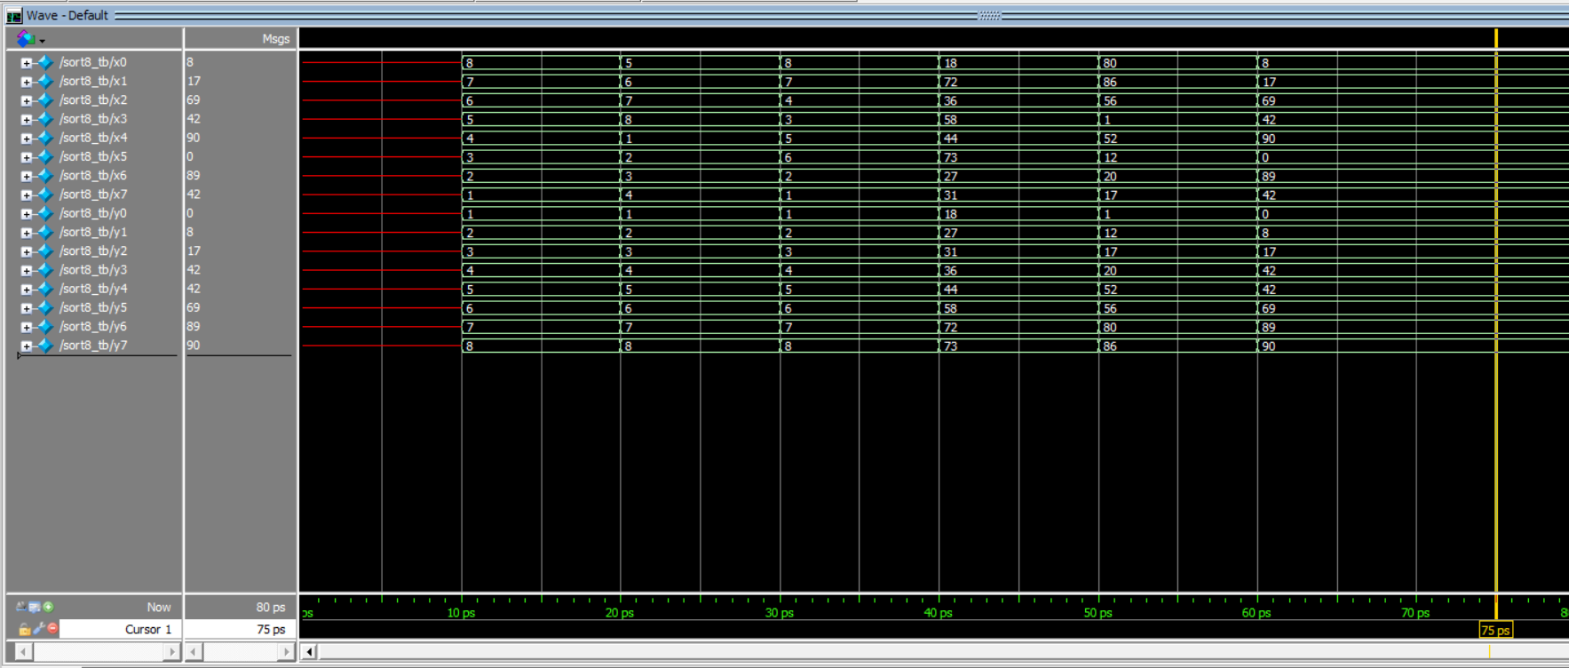
挑戰題 Simulation Waveform(無延遲)

Slide 12
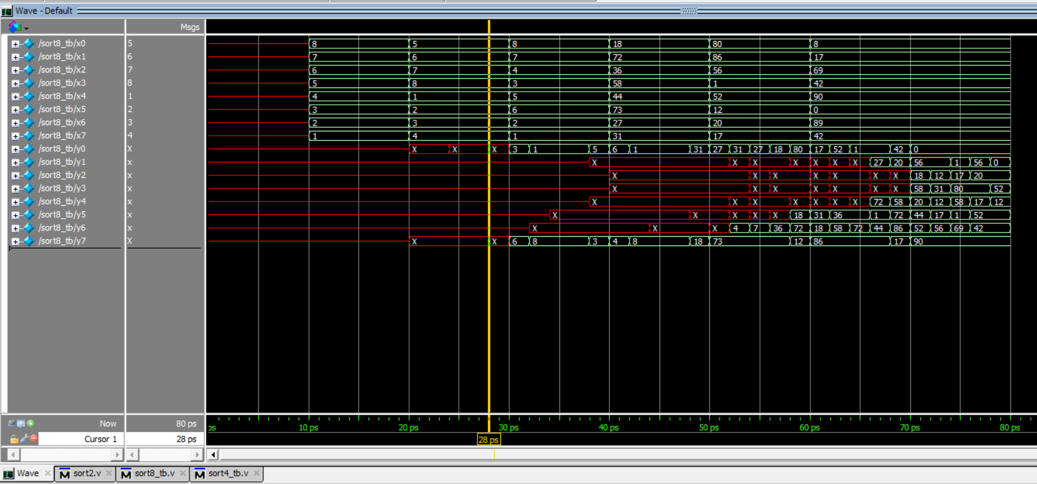
挑戰題 Simulation Waveform(有延遲#2)

